Slide 1
DarkSiders
A Demon Slaying Adventure

Slide 2

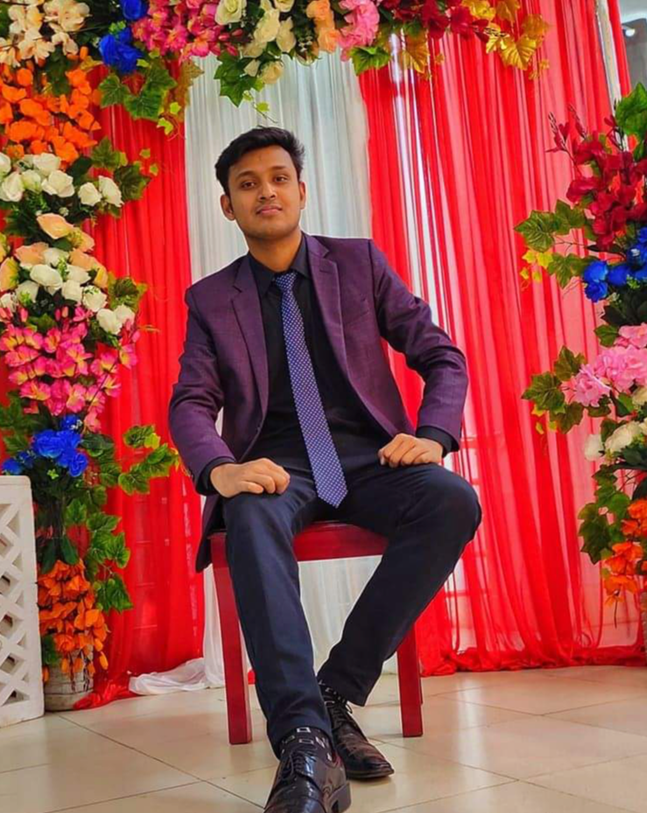

A presentation by–
Mahir Faisal
20220204073
Ahmed Nafis Shiam
20220204075
Likhon Saha
20220204065

Slide 3
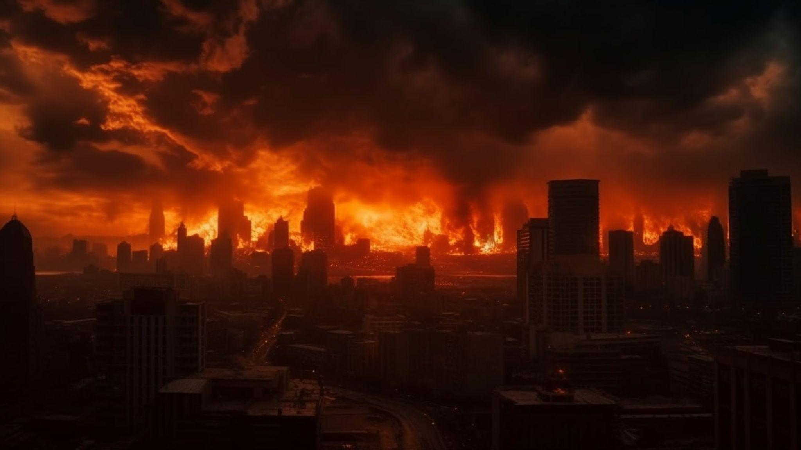
The History Of DarkSiders
Sudden one day a group of
enemy attacked our planet.
They destroy all over the place.
Now a hero must be save our planet from those bad guys.

Slide 4
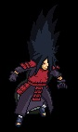
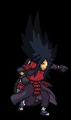
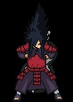
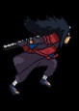
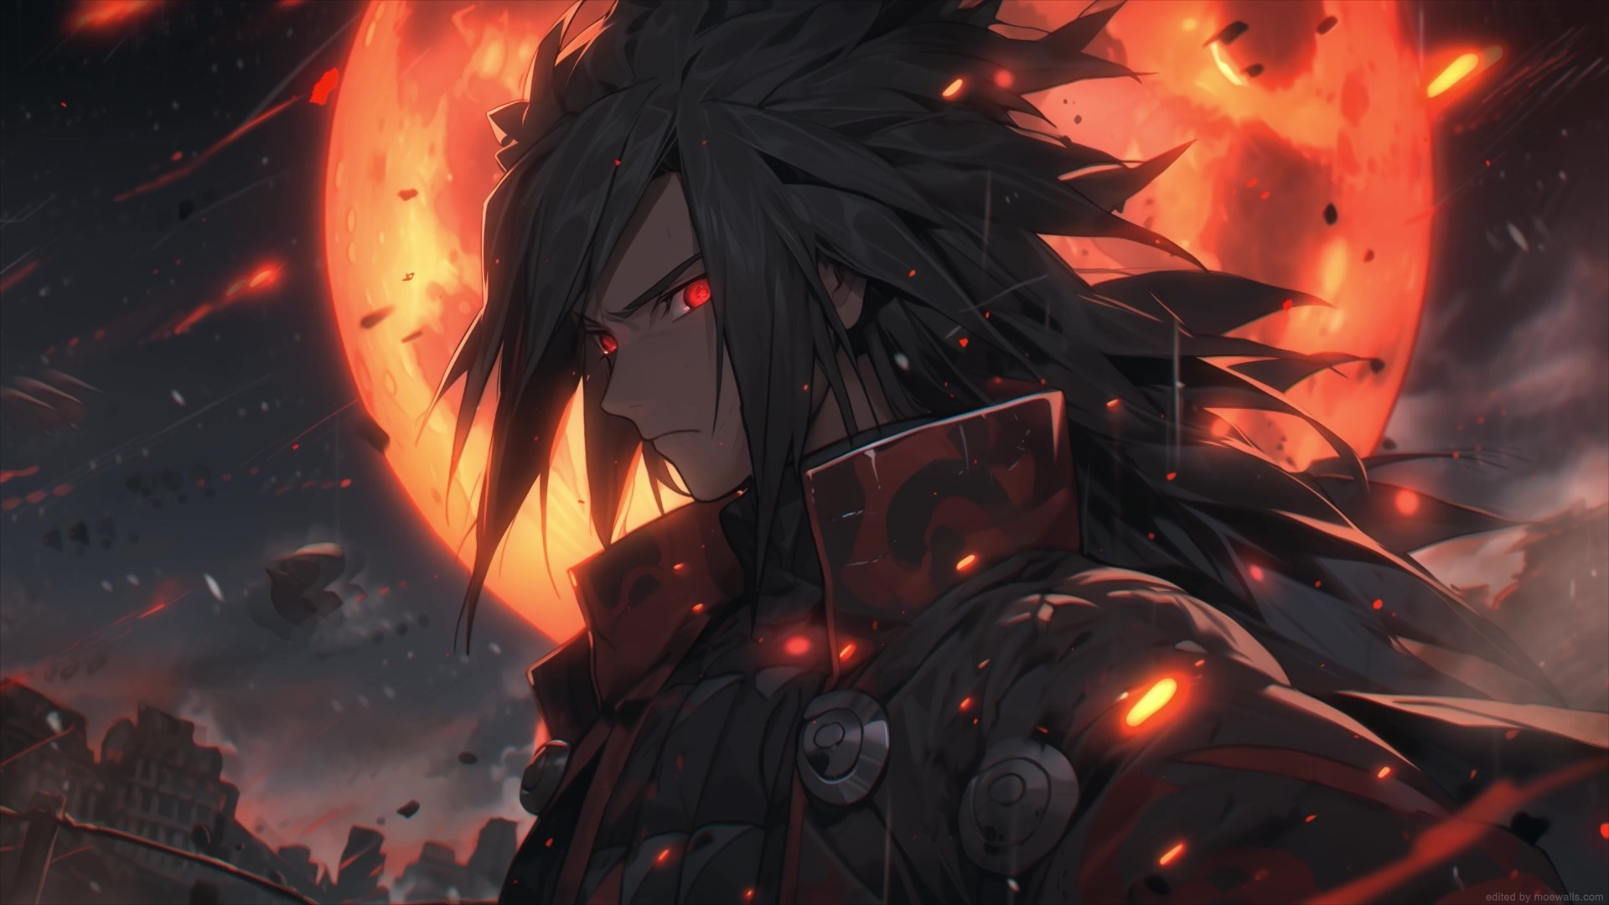




Madara Uchiha
Movements of our hero
The Hero Of DarkSiders
His special ability

Slide 5
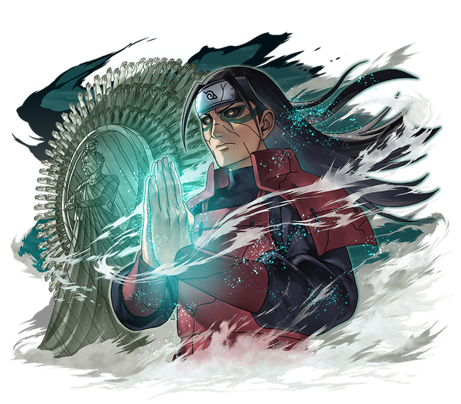
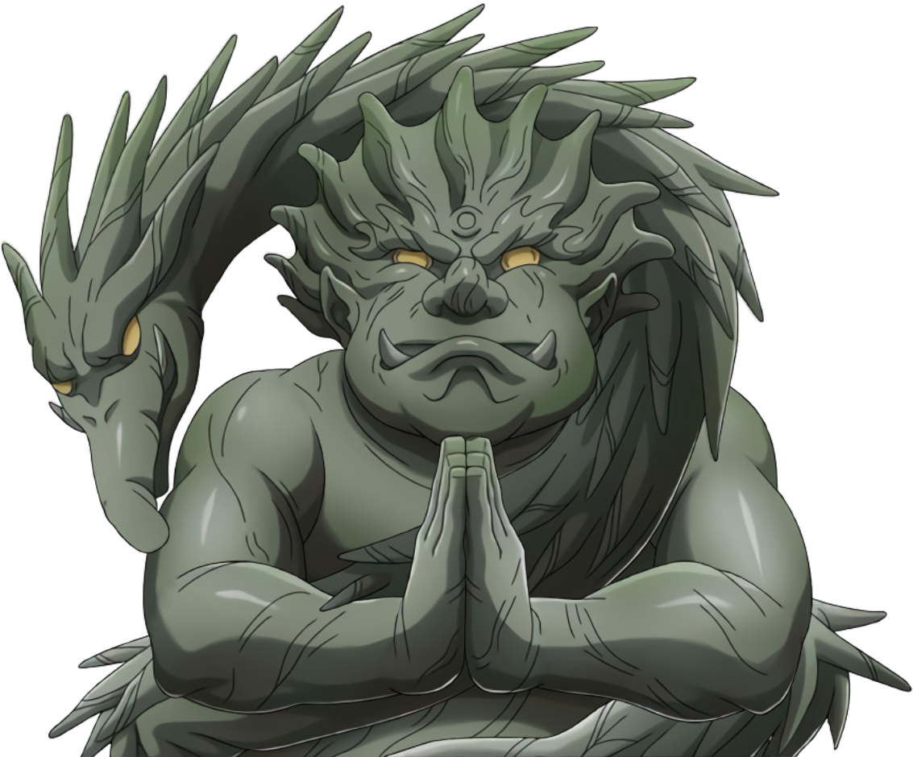
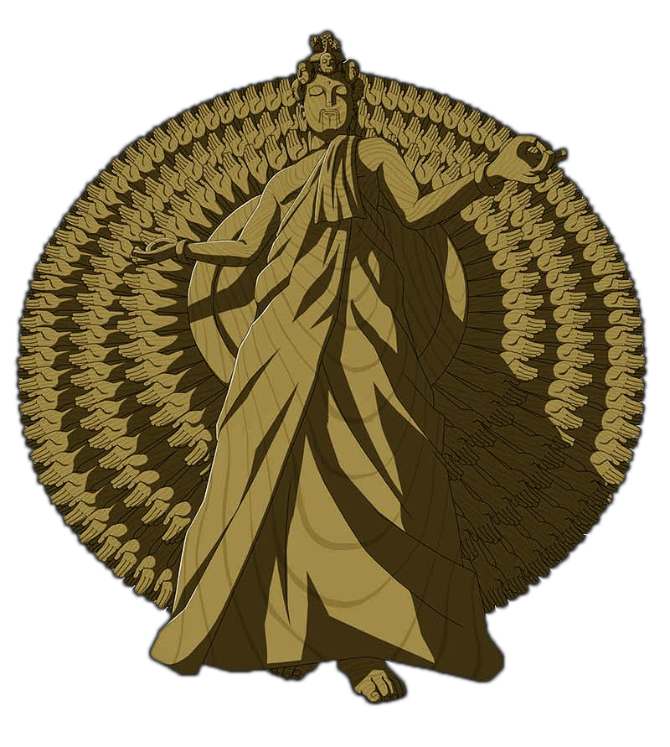
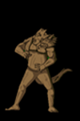
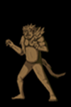
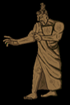
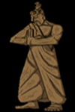
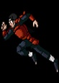
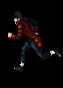
Villains
Level 1 villain
Level 2 villain
The main villain of DarkSiders
Level 1 movements
Level 2 movements
Movements of main villain

Slide 6
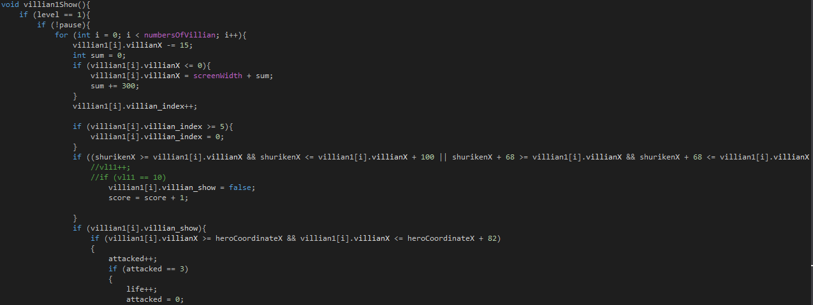
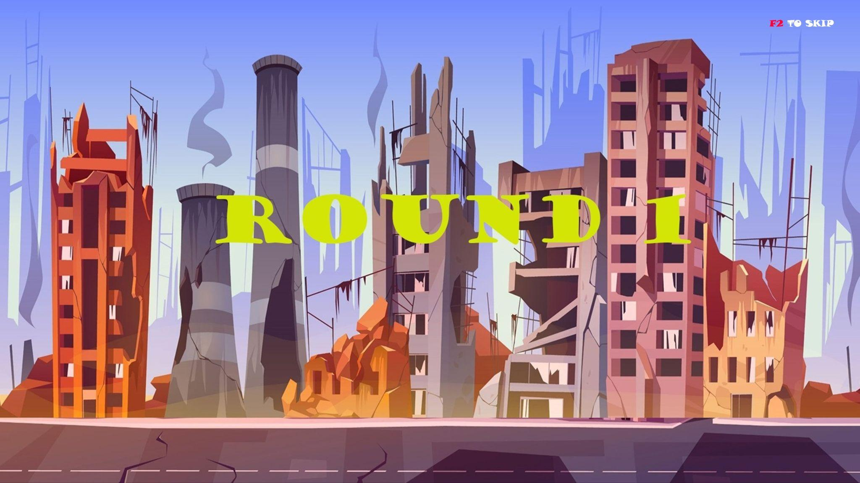
VILLAIN 1 COLLISION
We call villain functionalities,movement and collision from i-main.

Slide 7
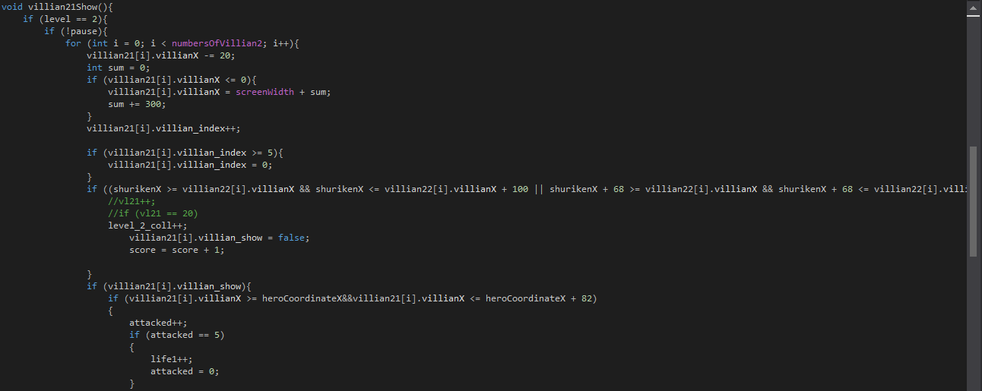
VILLAIN 2 COLLISION
Here we added our villain 2 functionalities and how the collision works. When the fire coordinates and villain coordinates matches the villain will vanish and score will update.

Slide 8
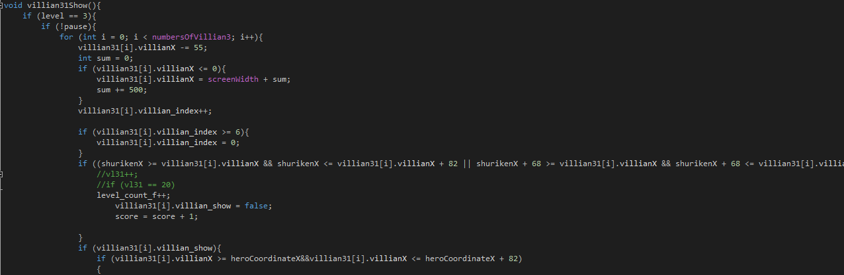
VILLAIN 3 COLLISION
In this code we make our final collision with our main villain.Firstly we set villain numbers and the distance between them. The main villain will come faster than previous one and the final collision will occur when both fire and villain coordinates matches with each other.

Slide 9
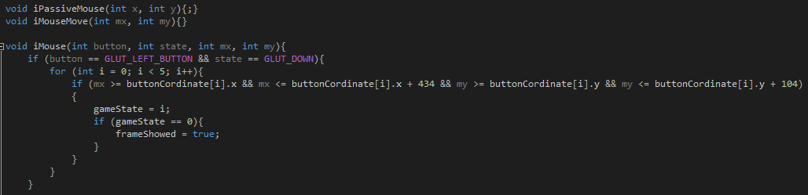
BUTTON FUNCTIONALITIES
MAIN HEADER CALL : We declare menu header in i-main with a loop then implement
the buttons and coordinates in menu header.

Slide 10
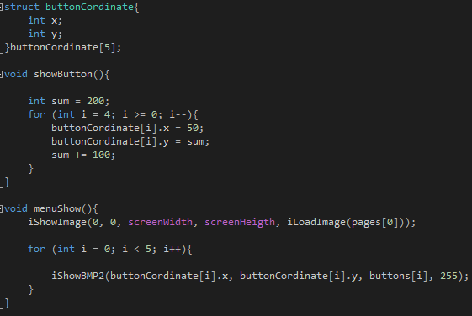
ADD BUTTONS
Button Coordinates with structure.Here we determine the buttons x,y coordinates with mouse and input them with loop.

Slide 11
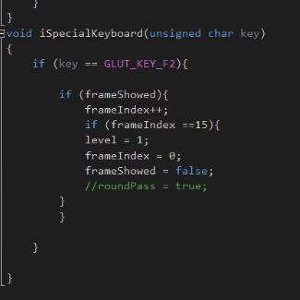
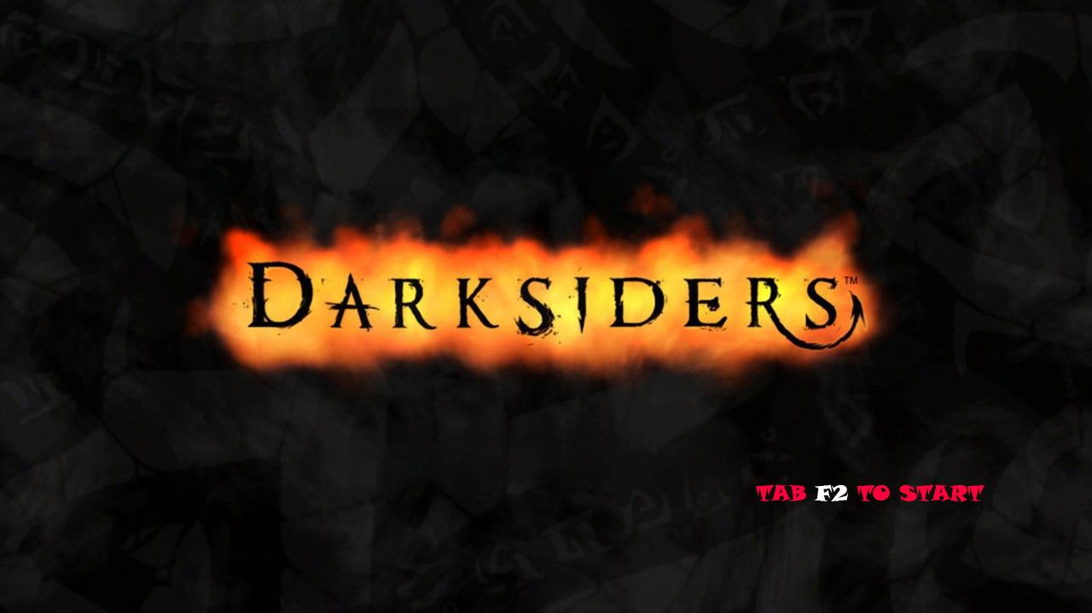
“iSpecial Keyboard”

Slide 12
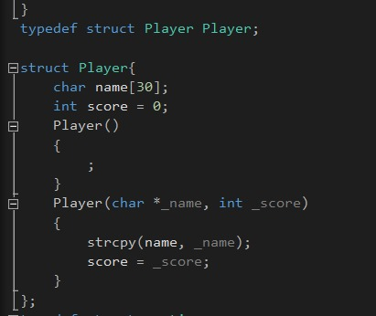
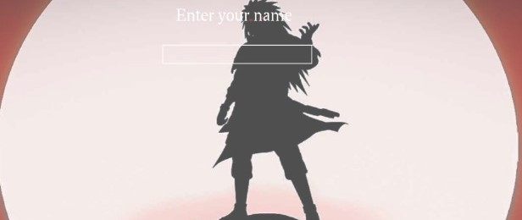
Insert Name

Slide 13
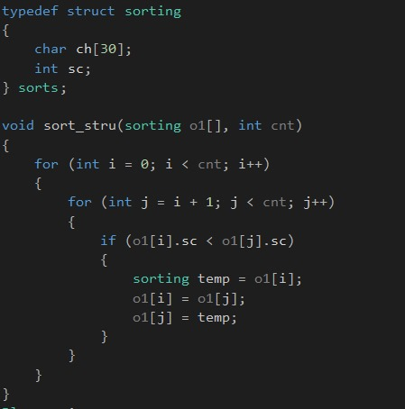
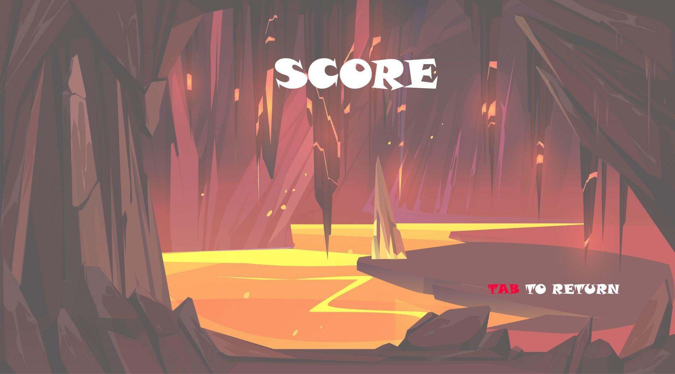
Highest Score

Slide 14
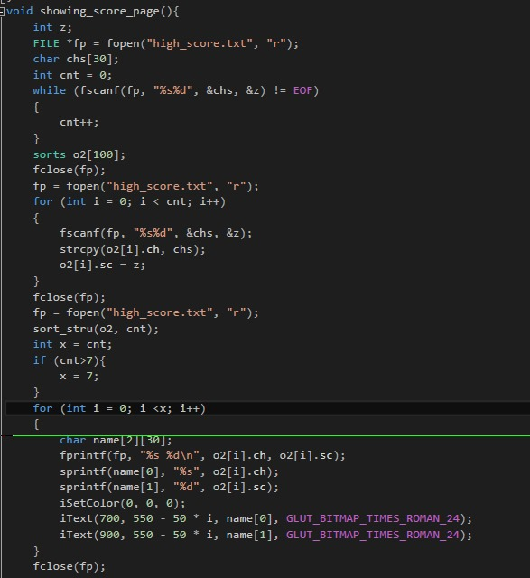
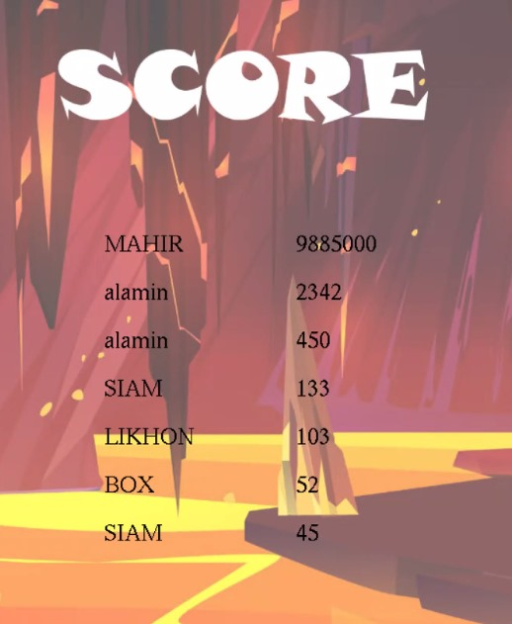
Sorting Score

Slide 15
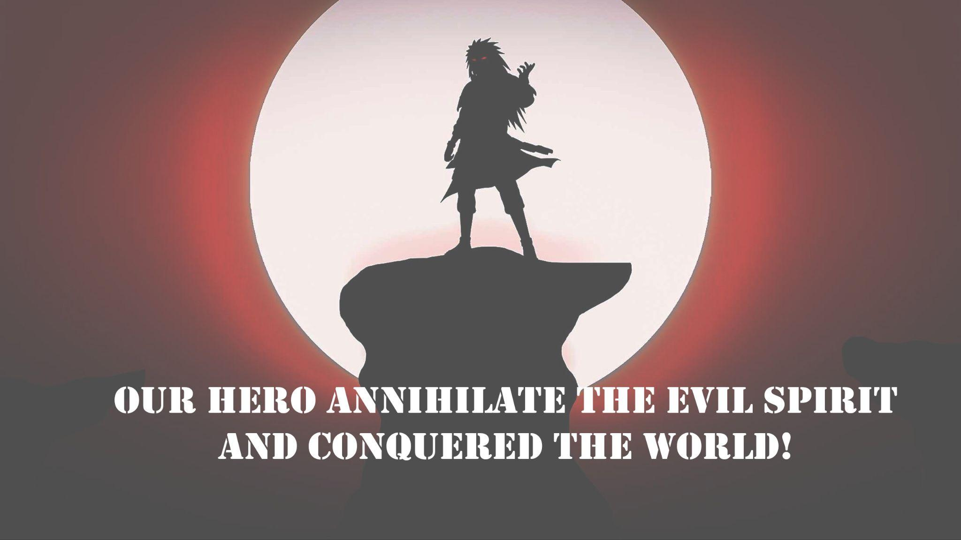
"Finally, our hero vanquished
all of the enemies."

Slide 16

"That's how we completed our game!!"

Slide 17
Thank You!

